Slide 1

Digital Integrated Circuits
A Design Perspective
Jan M. Rabaey
Anantha Chandrakasan
Borivoje Nikolic
Introduction

Slide 2
What is this book all about?
Introduction to digital integrated circuits.
  CMOS devices and manufacturing technology. CMOS inverters and gates. Propagation delay, noise margins, and power dissipation. Sequential circuits. Arithmetic, interconnect, and memories. Programmable logic arrays. Design methodologies.
What will you learn?
  Understanding, designing, and optimizing digital circuits with respect to different quality metrics: cost, speed, power dissipation, and reliability

Slide 3
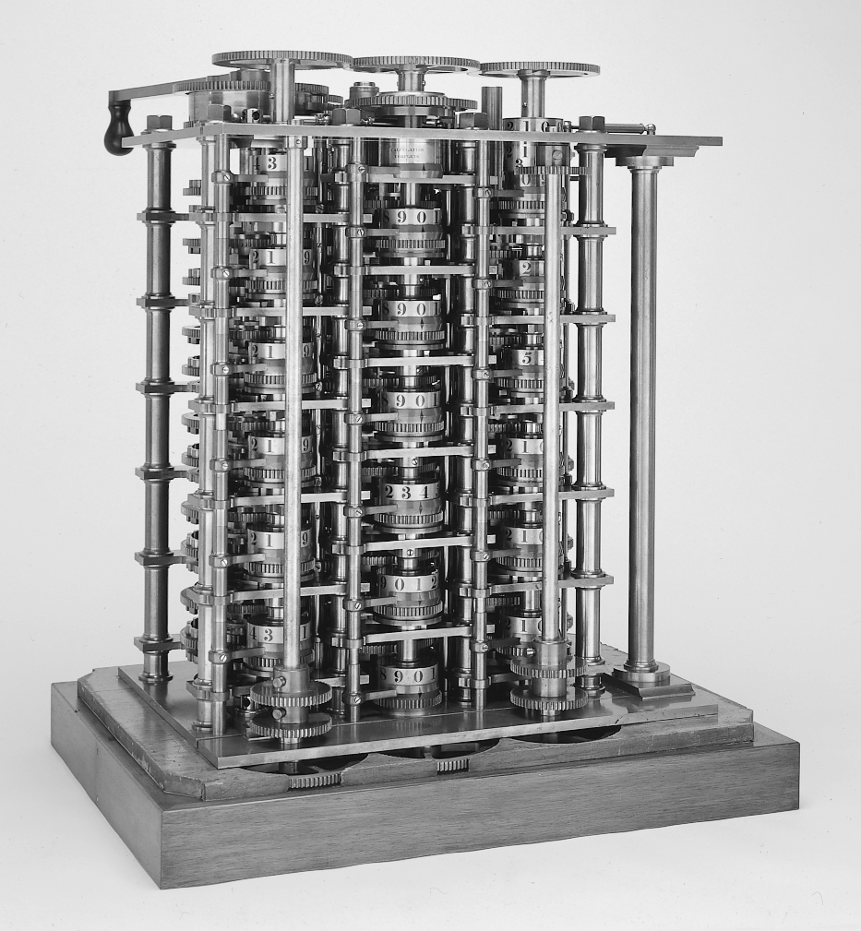
The First Computer

Slide 4
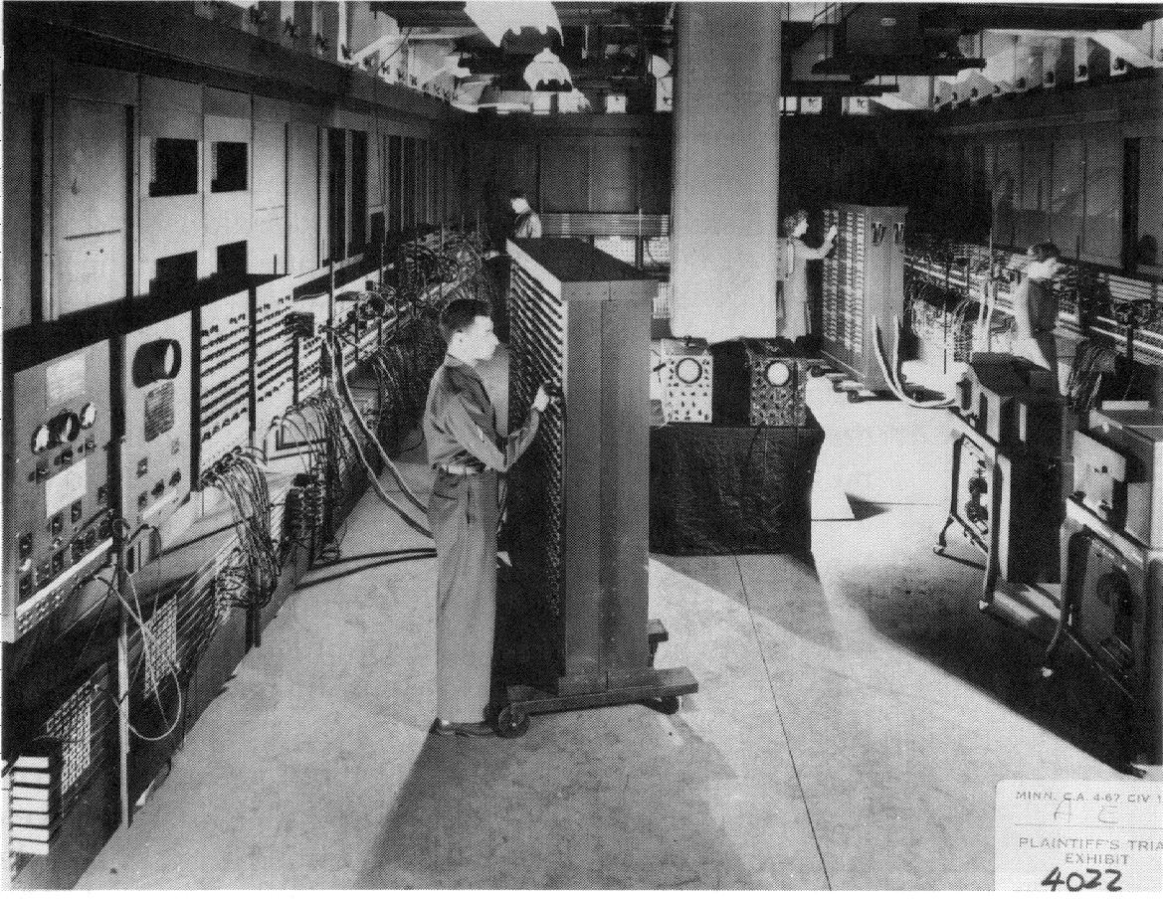
ENIAC - The first electronic computer (1946)

Slide 5
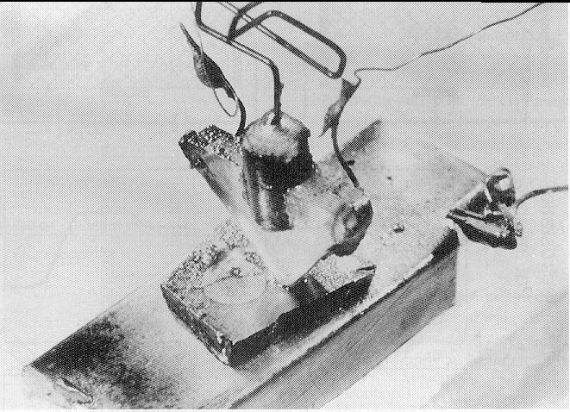
The Transistor Revolution
First transistor
Bell Labs, 1948

Slide 6
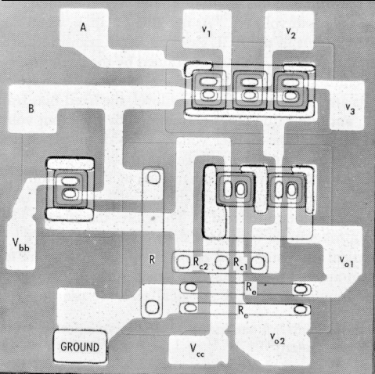
The First Integrated Circuits
Bipolar logic
1960’s
ECL 3-input Gate
Motorola 1966

Slide 7
Moore’s Law
In 1965, Gordon Moore noted that the number of transistors on a chip doubled every 18 to 24 months.
He made a prediction that semiconductor technology will double its effectiveness every 18 months

Slide 8
Moore’s Law
Electronics, April 19, 1965.

Slide 9
Design Abstraction Levels
SYSTEM
MODULE
+
GATE
CIRCUIT
DEVICE
G
S
D
n+
n+

Slide 10
Design Metrics
How to evaluate performance of a digital circuit (gate, block, …)?
  Cost
  Reliability
  Scalability
  Speed (delay, operating frequency)
  Power dissipation
  Energy to perform a function

Slide 11
Cost of Integrated Circuits
NRE (non-recurrent engineering) costs
  design time and effort, mask generation
  one-time cost factor
Recurrent costs
  silicon processing, packaging, test
  proportional to volume
  proportional to chip area

Slide 12
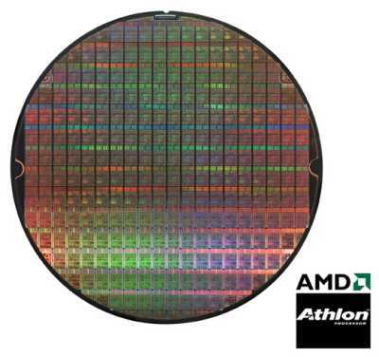
Die Cost
Single die
Wafer
Going up to 17.7” (45 cm)
From http://www.amd.com

Slide 13
Yield

Slide 14
Reliability―
Noise in Digital Integrated Circuits
v
(
t
)
V
DD
i
(
t
)
Inductive coupling
Capacitive coupling
Power and ground
noise

Slide 15
DC Operation
Voltage Transfer Characteristic
V(y)
VOH = f(VOL)
VOL = f(VOH)
VM = f(VM)
V
OH
f
V(y)=V(x)
V
Switching Threshold
M
V
OL
V
OL
V
OH
V(x)
Nominal Voltage Levels

Slide 16
Mapping between analog and digital signals
V
out
“
1
”
V
OH
Slope = -1
V
V
OH
IH
Undefined
Region
V
Slope = -1
IL
V
“
0
”
V
OL
OL
V
V
V
IL
IH
in

Slide 17
Definition of Noise Margins
"1"
V
OH
NM
Noise margin high
H
V
IH
Undefined
Region
NM
L
V
IL
Noise margin low
V
OL
"0"
Gate Output
Gate Input

Slide 18
Regenerative Property
Regenerative
Non-Regenerative

Slide 19
Regenerative Property
v
0
v
1
v
2
v
3
v
4
v
5
v
6
A chain of inverters
Simulated response

Slide 20
Fan-in and Fan-out
M
N
Fan-out N
Fan-in M

Slide 21
The Ideal Gate
V
out
R
=
∞
i
R
= 0
o
Fanout = ∞
NM_{H} = NM_{L} = V_{DD}/2
g = ∞
V
in

Slide 22
An Old-time Inverter
5.0
4.0
NM
L
3.0
(V)
2.0
out
V
V
M
NM
H
1.0
0.0
1.0
2.0
3.0
4.0
5.0
V
in
(V)

Slide 23
Delay Definitions

Slide 24
Ring Oscillator
T = 2
×
t
×
N
p

Slide 25
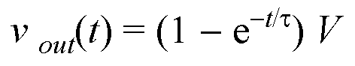
A First-Order RC Network
R
v
out
v
C
in
t_{p} = ln (2) τ = 0.69 RC
Important model – matches delay of inverter

Slide 26
Power Dissipation
Instantaneous power:
p(t) = v(t)i(t) = V_{supply}i(t)
Peak power:
P_{peak} = V_{supply}i_{peak}
Average power:

Slide 27
Energy and Energy-Delay
Power-Delay Product (PDP) =
E = Energy per operation = P_{av} × t_{p}
Energy-Delay Product (EDP) =
quality metric of gate = E × t_{p}

Slide 28
A First-Order RC Network
R
v
out
v
in
C_{L}

Slide 29
Summary
Digital integrated circuits have come a long way and still have quite some potential left for the coming decades
Some interesting challenges ahead
  Getting a clear perspective on the challenges and potential solutions is the purpose of this book
Understanding the design metrics that govern digital design is crucial
  Cost, reliability, speed, power and energy dissipation

